Slide 1

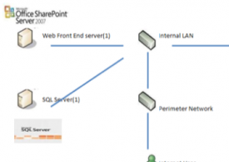
SharePoint Business Intelligence ROI Calculator
The Challenge
<p>Microsoft needed a way to estimate licensing costs of various software solutions based upon several complex factors so they asked for a custom SharePoint Business Intelligence tool.</p>
What We Did
<p>Using SharePoint, Affirma built a calculator to determine the number of software licenses needed.&nbsp;The calculator factors in multiple variables such as anticipated system load, installation best practices, number of employees, and other factors.</p>
Results
<p>The field sales team has heavily leveraged the ROI Calculator to give clients broad estimates on cost. This custom business analysis tool was created using SharePoint Business Intelligence features.</p>

